Slide 1
Activation Programs in Georgia
Activation and Graduation Policies in the South Caucuses and Central Asia
Summary of key points from Policy Note
Maddalena Honorati, World Bank
Government representative (tbc)

Slide 2
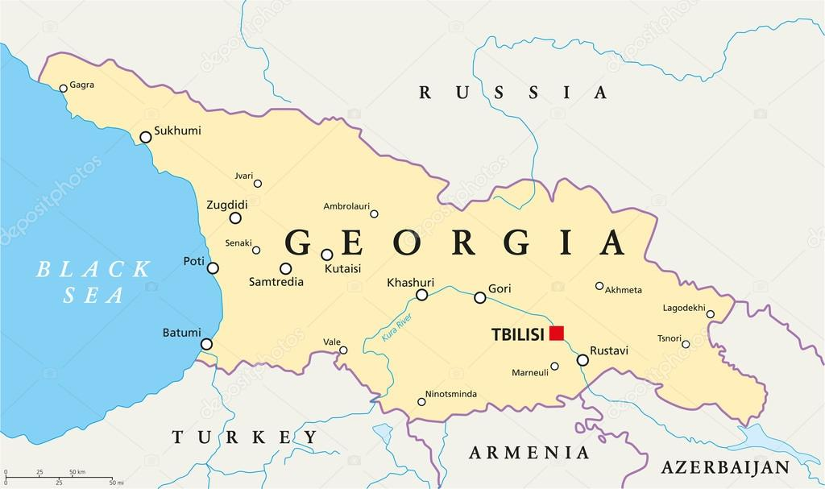
Table of Contents
    Overview / Context
    Social Assistance Policies and Programs
    Labor Market Policies and Programs
    Challenges
    Recommendations / Roadmap

Slide 3
Overview / Context
Economic growth and poverty trends
Labor market and employment trends

Slide 4
Economic Development and Poverty Trends
Economic growth in Georgia has mostly been strong in the past two decades
High rank (No.7 worldwide) for ease of doing business (“Doing Business 2020”).
Poverty headcount: dropped from 38.8 to 21.9%
Int’l poverty line (3.20 US$) – 16.3%.
Poverty reduction driven by labor income, pensions, and social assistance.
Less than half the population and two-thirds of the poor live in rural areas.
Poverty reduction has been much more significant in urban areas.
Activation Programs in Georgia

Slide 5
Labor Market and Employment Trends
The workforce:
    Has become more educated over time, but lags behind other European countries.
    Is shrinking rapidly due to aging, decreasing fertility, and emigration.
Labor force participation: 67.7% (WDI) / 65.8 (2017 LFS)
    Men: 78.6% / 74.5% Women: 57.7% / 58.2%
    2006 - 2018: LFP rate increased significantly (over 10%) for all age groups except the youth.
Unemployment: 11.6% (2017 and 2018)
    Higher among men (as percentage of male labor force)
    3.5 times higher in urban areas
    Very high among youth: 30% (including 26.2% for men and 34.4% for women)
High NEET rate:
20% of young Georgians (15-30 years) are not in employment, education or training
Female NEET rates are almost five times higher than male’s rates in Georgia
    Significant gender gap in key labor market indicators
Activation Programs in Georgia

Slide 6
Main Determinants of Supply and Demand for Labor
High level of informality: 51.8%
    Formal sector has increased over time
    Most of this informality comes from the agriculture sector
    The incidence of informal agricultural employment is higher for women compared to men
    In informal non-agricultural employment, 76% of all workers are men
    Over 40% of the Georgian workforce engaged in agriculture
Stagnant employment despite economic growth and poverty reduction
    Georgia is not creating as many jobs as its economic growth would predict / limited vacancies and new job openings
    Lack of relevant skills and qualifications of the locally available workforce for the limited number of vacancies and new job openings
    Vast number of small firms
    Concentration of labor in predominantly low-productivity sectors
Activation Programs in Georgia

Slide 7
Current Policies and Programs
Social Assistance

Slide 8
Social Protection, Social Assistance and Labor Market Programs
SOCIAL ASSISTANCE AND SOCIAL SERVICES
Old-age pension: universal flat-rate and unrelated to previous earning or work pension for men above 65 and women above 60 years of age
Survivor’s pension: state budget financed and granted to children till the age of 18 in case of loss of bread winner, regardless of cause of death (industrial injury, occupational sickness, or non-work-related sickness or injury)
Guaranteed minimum resources/last resort income support: TSA
Disability: pension irrespective of whether incapacity is work related or non-work related; fixed rates for persons with severe degree of disability (1st group), children with disability(es) and persons with moderate degree of disability (2nd group). Social rehabilitation services for persons with disabilities
Maternity/paternity: cash and n-kind benefits (leave) – a social insurance scheme financed by the SSA that provides non-earning related benefits to all employees; all residents are covered for maternity care, except for public servants, maternity care of which is paid by the public authority
Benefits and services for Internally Displaced Persons (IDPs) from the occupied territories
Family benefits: universal child benefit for the 3rd and each next child in the family until 2 years of age of the child – flat rate, which is higher for children living in high mountain areas; poverty targeted monthly child benefit since 2015 – targeted at around 40 percent of children between 0 and 15 years of age living in families with lower welfare scores
Benefits and services for war veterans
Social care services: mostly centralized universal system not linked to economic activity and/or payment of contributions, including institutional care for people with disability, for children deprived from parental care and for elderly; and alternative day care centers, small group homes, and community-based services; no benefits for informal care givers
Myriad of social benefits administered at the local level (for example health exemptions, education exemptions, housing benefits, energy and transportation subsidies, certain social care services)
CONTRIBUTORY PENSION AND EMPLOYER’S LIABILITY
Contributory pension: as of 2019, mandatory for employed under the age of 40
Employment injuries and occupational diseases: compensations for injuries caused by the fault of the employer
ACTIVE LABOR MARKET PROGRAMS
Categorical benefits prevail, the Targeted Social Assistance (TSA) is targeted to the poor
Social assistance is dominated by the non-contributory social pension

Slide 9
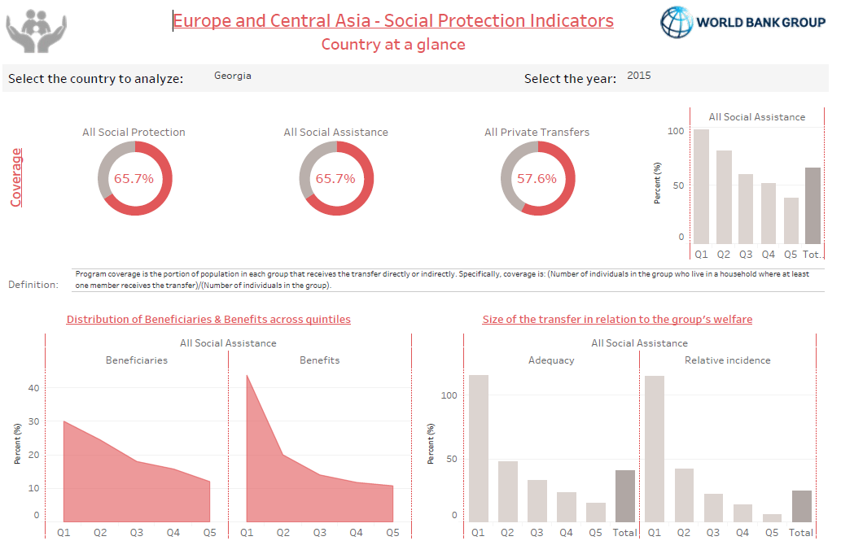
Social Assistance Performance

Slide 10
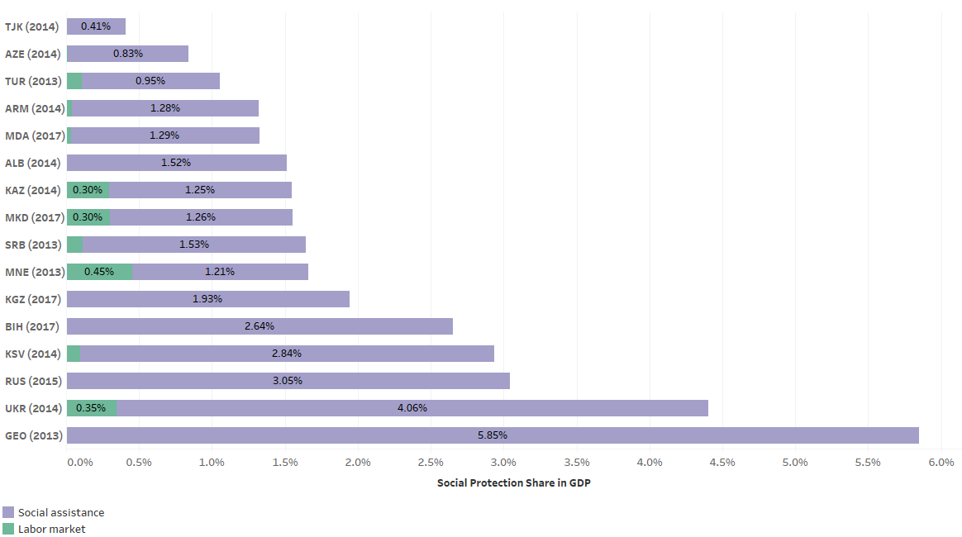
Spending on Labor Market and Social Assistance Programs
    Social assistance programs cover 13% of the population
    Spending on labor market programs is low
    Social assistance spending of almost 6% of GDP, social pension included, is high by regional standards (ECA average is 2.2 percent of GDP), but
    Low, if the social pension is excluded – 1.2% of GDP (2013)
    High spending by regional standards on the poverty targeted social assistance scheme
Activation Programs in Georgia

Slide 11
Last-resort Income Support Scheme / TSA: design, performance and delivery
Targeted Social Assistance (TSA): i) Provides cash for the extremely poor and vulnerable using Proxy Means Test (PMT); ii) In 2018 covered about 121 000 households or t 450 000 people)
TSA has had continuous design improvements: i) Updating the PMT → increased program coverage; ii) Child benefit increased from 10 GEL to 50 GEL iii) New delivery mechanism for child benefit – “Child Nutrition Card” d) Introduced five tiers of child benefit recipients;
TSA has design elements aimed at promoting activation: a) Introduced tiers / gradual reduction of TSA depending on PMT score; b) Income disregard and gradual phase-out of TSA and other benefits in case of wage income;
The Social Service Agency (SSA): i) Administers the program iii) Maintains the Unified Database of social registry
TSA is one of the best performing last-resort income support programs in ECA: i) Covers 35% or the poorest quintile (2017); ii) Pro-poor targeting: 75% of benefits to the poorest quintile; iii) Reduces both poverty headcount and poverty gap (best performer in ECA in terms of poverty headcount reduction (as % of the pre-transfer index))
Activation Programs in Georgia

Slide 12
Current Policies and Programs
Labor Market Programs

Slide 13
Labor Market Strategy, Labor Market Information System (LMIS) and Worknet
New National Labor and Employment Strategy 2019-2023: i) promotes employment and is being complemented by broader initiatives including: i) Creating a Labor Market Information System ; ii Worknet online portal; iii) ALMPs;
MIS (MILHSA): to improve the availability, consistency, and reliability of LM information
    It is “One-stop shop” information bank that provides data to users, reduces the cost of job search, supports LM policy formulation, and enables M&E of LM policies
Maintaining the LMIS is complex and requires coordination and cooperation of multiple Ministries and Agencies (MILHSA set up the LMIS; MoESD maintains and administers the LMIS; The SSA provides information on job seekers and available vacancies; etc.)
Worknet:
i) job seekers and employers register online via the Worknet portal.
ii) Worknet consultants ensure the smooth functioning of the portal
iii) As of June 2018, 161 611 persons had registered on the system as jobseekers
Activation Programs in Georgia

Slide 14
Active Labor Market Programs
1. State Program on professional training and retraining and qualification raising of job seekers
2. Employment Support Services / Wage Subsidies
3. Intermediation services
4. Employment promotion services
5. Job fairs and mass interviews
6. Internship program to boost employment of mostly vulnerable groups (unemployed, low-skilled, youth, stateless people, people with special needs)

Slide 15
State Program on Training and Retraining and Qualification Raising of Job Seekers
Objective: Increase competitiveness of job seekers and promote their employment through vocational training in demanded professions and internships
    Two components of the program: (i) a short Vocational Education and Training, and (ii) a Professional Internship at Enterprises
    Eligibility: citizens above 16 years but specifically targeted stateless people with special humanitarian or refugee status and registered Worknet applicants’
In 2018, the state budget allocated US$ 705 000 for the program; Beneficiaries received government-issued vouchers and stipends for the training or internship (in 2017, 2130 job seekers successfully completed the training and 2360 job seekers received the voucher)
The program has a feedback mechanism wherein graduates of the programs are interviewed after completing the training
    However, there is no systematic and rigorous M&E of the program

Slide 16
State Program on Employment Support Services/ Wage Subsidy and Employment Promotion and Intermediation Services
1) Employment support for people with special needs and youth (18 to 29 years)
    Employment subsidy component: a) the government finances 50 percent of the employee’s salary; b) Employers are obliged to sign a labor agreement with the beneficiary for at least 6 months;
    Small-scale ALMP - 23 employees received wage subsidy in 2018 (down from 59 in 2017)
    Employment support / consultants group component: a) employment consultants select jobseekers (persons with disabilities only) involved in the subsidy program to make them more competitive in the job market
2) Employment Promotion Service: counselling and career planning services, provided at the municipal level by SSA staff; Priority is given to vulnerable groups
Intermediation services:
The Department of Employment Programs provides intermediation services linking employers and job seekers
In 2018, 1323 were registered, down from 2500 in 2017

Slide 17
Job Fairs and Internships
Job fairs and mass interviews
    The Department of Employment Programs organizes job fairs and mass interviews
    The job fairs are an opportunity for job seekers and employers already registered on the Worknet portal, development organizations, and education centers to interact and network
Internship program to boost employment
    Job seekers are provided internship opportunities for one to three months, determined jointly with the employer
    During the internship, the job seeker is financially supported with a monthly scholarship
    In 2018, internship agreements were signed with 41 organizations. 173 job seekers were involved in the program. Among these, 61 found employment

Slide 18
Challenges

Slide 19
Challenges
Low overall demand for labor due to limited vacancies and job openings and lack of relevant skills and qualifications of the available workforce for vacant jobs
ALMPs – recent, of small-scale and underfinanced
Gaps in the institutional set up for ALMPs implementation and weak inter-institutional coordination
Weak monitoring and evaluation of programs, limited follow-up on registered with the Worknet
Activation Strategy is not yet in place
Potential disincentives related to the TSA benefit design and implementation

Slide 20
Challenges related to demand and supply of labor, and lagging behind strategy development
Georgia is not creating as many jobs as its economic growth would predict
Lacking are relevant skills and qualifications of the locally available workforce for the limited number of vacancies and new job openings
Political instability and lack of adequately skilled workers continue to be constraining factors to doing business. However, Georgia has one of the most enabling business environments relative to other countries in the region
The workforce is shrinking due to low fertility rates and outer migration, and high inactivity rates especially among young people and women
Those who are working are employed in low-skill, low-quality and low-productivity jobs
The MILHSA Activation Strategy is not yet prepared to specify the strategic vision and challenges related to enabling and demanding conditions, targeting of beneficiaries, activation instruments, institutional setup and institutional coordination

Slide 21
ALMPs scale and spending, and institutional setup for activation
The ALMPS have been introduced in the recent years and are small in scale
The spending on activation measures and services is small
The institutions which are supposed to develop policies and implement ALMPS across the country are new, understaffed and underfunded
The institutional capacity of the SSA Employment Department to meet its core mandate is still limited. The SSA lacks financial and human resources to implement large-scale programs effectively across the country
The MILHSA Employment and Labor Policy Department is understaffed. It was set only recently and has fewer than 20 employees
implementation heterogeneity of employment programs and services across and within regions
      The poverty levels and informality rates are higher in rural areas compared to urban areas. Job growth and poverty reduction has also been more pronounced in urban areas compared to rural areas in the recent past.

Slide 22
Weak monitoring and evaluation, TSA design and implementation related challenges
M&E: There are no systematic and rigorous evaluations that would allow to adjust targeting and design of ALMPs: i) ALMPs are relatively new in the country, there is no impact evaluation process within the SSA or under the MILHSA; ii) also, there is no proper monitoring system to track ALMP beneficiaries
The Worknet system does not have follow-up provisions with jobseekers who received a job through the system: i) The program merely tracks the number of employed and unemployed persons but does not monitor their trajectory—how long those who got employed stay in the job, the salary level, job growth
TSA: Only partial and fragmented information on the employability and LM participation constraints of TSA beneficiaries
TSA beneficiaries are obliged to register in Worknet and this registration is separate from the registration with the TSA registry
TSA beneficiaries are not targeted for activation and graduation with specific program(s); There are no sanctions for not actively looking for a job

Slide 23
Recommendations / Roadmap

Slide 24
Recommendations / roadmap: short-term
Design more effective, diversified and available for all ALMP models, and pilot new programs and measures aimed at improving the skills, qualifications and competitiveness of the locally available workforce:
ALMPs with focus on skills which are in demand by employers:
    Apprenticeships for vulnerable jobseekers, specifically youth, on the job training to help jobseeker acquire “hands-on skills”/jobs specific skills and possibly employment
Develop entrepreneurship programs for hard-to-employ groups on the LM trough:
    new self-employment program (this can include business development training, small grants and/or credits, for business start-ups combined with advice and follow up coaching and mentoring) tailored to hard-to-employ
Improve M&E system for ALMPs:
    rigorous evaluation that would allow to adjust targeting and design of existing and newly developed ALMPs;
    track ALMP beneficiaries;

Slide 25
Recommendations / roadmap: short-term
Institution building
Establish the business model of a public employment service in the SSA Employment Department
Labor Market Informational System: Strengthening the Worknet
    Improving the Worknet software for better matching jobseekers to jobs
    Further specification of the role and responsibilities of Worknet including increase in its information content and in the possible use of job coaches and follow up / tracking of beneficiaries
Conceptualize and design activation measures for TSA beneficiaries
Concept for TSA program reform to incentivize active job seeking and participation in the labor market, and to reduce potential disincentives to work, such as:
    conditions (to demonstrate active job search behavior, accept suitable job offers and participation in ALMPs), and sanctions for non-compliance
    benefit design changes - income disregards, gradual phase-out of TSA or higher scores or threshold for exit from the TSA
    ALMPs (new, and/or adaptation of existing programs) tailored to graduation of TSA beneficiaries, such as support for self-employment, entrepreneurship and rural cooperatives

Slide 26
Recommendations / roadmap: medium-term
Strengthen the flagship state employment promotion programs (State Program on professional training and retraining and qualification raising of job seekers, and Employment Support Services / Wage Subsidies)
Sale up the programs
Expand their outreach to all hard to employ jobseekers
Reform VET curricula and delivery methods to align with the demand of businesses:
Develop curricula that evolve through continuous dialogue with employers / private sector to identify high demand technical and core skills to help formulate the curriculum and align it with business needs
Increase capacity for collection and analysis of data on the demand for labor, to inform policy making

Slide 27
Recommendations / roadmap: medium-term
Programs for adults supporting lifelong learning:
Competence-based training organized as series of shorter modules and
built-on recognition of prior learning;
A partnership involving relevant ministries and adult learning stakeholders
including employers could be establish
Strengthening service delivery by allocating sufficient financial and human resources and by strengthening institutional capacity to effectively deliver ALMPs
Enhance the outreach to vulnerable groups on the labor market through:
  casework
diversified providers of employment services

Slide 28
contacts
World Bank
Marijana Jasarevic | Social Protection Specialist | Belgrade | mjasarevic@worldbank.org
Renata Gukovas | Research Analyst | Washington | rgukovas@worldbank.org
Boryana Gotcheva | Consultant | Sofia | gotchevab@gmail.com

